Slide 1
History of Greater Manchester Netball County Association
-Known as GMCNA
Established in 1974!

Slide 2


How did GMCNA begin?
The Greater Manchester County Netball Association (GMCNA) was established in 1974, following changes to county boundaries under the Local Government Act. Prior to this, teams and players in the area were affiliated with either Lancashire or Cheshire. With the creation of the Greater Manchester metropolitan county, GMCNA was formed to support netball across the newly defined region.
County colours were decided by the colour of someone who was knitting in the first meeting and the wool colour was orange!

Slide 3
Honorary Positions with England Netball
Honorary Life Members
Long Service Awards
Barbara Bishop
Cheryl Dewhirst
2019 -Angela Hoyle
2019 - Kath Edwards
1993 - Angela Hoyle, Kath Moss, Yvonne Spurrell, Alice Thornley, Mavis Yates
2006 - Jan Turley
2007 - Jacqueline Ashworth & Kath Edwards
2008 - Kath Pemberton
2009 - Janet Murray
2016 - Cheryl Dewhirst
2019 - Mary Slade

Slide 4
Honorary Positions with GMCNA
Eva Barnes
Alexena Morrison
Alice Thornley
Mavis Yates
Iris McGarva
Honorary Life Member &
Hall of Fame Legends
Honorary Life Members
Eva Barnes
Alexena Morrison
Alice Thornley
Mavis Yates
Iris McGarva
2025 - Kath Moss
2025 - Kath Edwards
2025 - Kath Pemberton
2025 - Janet Murray
Hall of Fame
2025 - Sam Longley
2025 - Sandy Castell
2025 - Pat Evans
2025 - Dawn Day
2025 - Lesley Smith
2025 - Terri Monaghan
Hall of Fame - Service to Netball
2025 - Cheryl Dewhirst
2025 - Joan Dunn

Slide 5
Presidents of GMCNA
1974-1982 – Ellen Marsh
1982-2002 – Alice Thornley
2002-2012 – Barbara Bishop
2012 – to date - Kath Pemberton
Vice Presidents of GMCNA
1974-1976 – Marion Wall
1976-1982 – Alice Thornley & Gerry Daly
1982-2002 – Barbara Bishop
1982 - 2006 - Iris McGarva
1982- 1997 - Alexena Morrison
2006 – to date - Kath Moss

Slide 6
Vice Chairman of GMCNA
Chairman of GMCNA
1974-1977 – Barbara Bishop
1977-1978 - Zandra Taaffe
1978-1980 – Mavis Yates
1980-1982 – Gabrielle Bramwell
1982-1984 – Kath Edwards
1984 – 1990 - Vacant
1990-1991 – Jan Bleasdale (Turley)
1991-2005 - Vacant
2005-2006 – Jean Moorhouse
2006-2008 – Kath Pemberton
2008-2010 – Dawn Day
2010-2012 – Sam Longley
2012 – to date – Sandy Castell
1974-1977 – Kathleen Moss
1977-1978 – Barbara Bishop
1978-1980 – Yvonne Spurrell
1980-1982 – Mavis Yates
1982-1984 – Gabrielle Bramwell
1984-1986 – Kath Edwards
1986 – 1988 – Jacqueline Ashworth
1988-1991 – Kathleen Moss
1991-1993 – Jan Turley
1993-1995 – Kathleen Moss
1995-1997 – Yvonne Spurrell
1997 - 2006 - Kathleen Moss
2006-2008 – Jean Moorhouse
2008 – 2012 – Kath Pemberton
2012 – to date - Sam Longley

Slide 7
Secretary of GMCNA
1974-1975 – Mae Egan
1975-1976 – Pat Turner
1976 – 1981 – Eileen Carleton
1981-1984 – Jacqueline Ashworth
1984 – 1985 – Chris Jones
1985 – 1989 – Joan Kirkham
1989 – 1990 – Jacqueline Ashworth
1990 – 1991 – Cheryl Moss
1991 – 1993 – Sandra Bostock
1993 – 2006 - Mavis Yates
2006 - to date - Pat Evans
Minuting Secretary of GMCNA
1990-1991 – Jacqueline Ashworth
1991-1992 – Hazel Chapman
1997-1998 – Eileen Carlton
1999-2002 – Judith Smith
2002-2005 – Jean Moorhouse
2005 – 2006 – Vacant
2006-2008 – Jacqueline Ashworth
2008-2011 – Jean Moorhouse

Slide 8
Treasurer of GMCNA
1974-1977 – Celia Keighley
1977 – 1978 – Mary Burchill
1978 – 1984 – Joan Dunn
1984 – 1990 – Tracy Wood
1990 – 2009 – Mary Slade
2009 - to date - Janet Murray
Affiliation Secretary of GMCNA
1990-1998 - Janet Murray
1998- 2000 – Barbara Ruff
2000 – 2004 – Janet Murray
2004 – 2011 – Shelley Walker
2011 – to date – Janet Murray

Slide 9
Umpiring Secretary
Coaching Secretary
1974-1981 – Iris McGarva
1981-1984 – Kath Edwards
1984-1985 – Ken Stott
1985-1986 – Kath Edwards
1986 – 1991 – Julie Chapman
1991 – 1993 – Unknown
1993 – 1996 – Jan Turley
1996-2008 - Kath Pemberton
2008- to date - Teresa Mongahan
1974-1976 – Yvonne Spurrell
1976-1982 - Kathleen Moss
1982-1984 – Mary Hayley
1984 - 2008 - Angela Hoyle
2008-2010 - Debbie Morgan
2010 to date - Lesley Smith

Slide 10
Positions From County League & Competition Days
Senior Coach
1974-1978 – Yvonne Spurrell
1978-1981 – Gabrielle Bramwell
1981-1983 – Mary Lavin
1983 – 1990 – Gabrielle Bramwell
1990-1992 – Iris McGarva
1992- 1993 – Joan Kirkham
1993 – 1995 – Pam Heath
1995 – 2001 – Janet Douthwaite
Senior Assistant Coach
2001 – 2003 – Kath Pemberton
2003 – 2004 – Paul Harper
Senior Team Manager
1991-1992 – Joan Kirkham
1998-2000- Shirley Grimsditch
2001-2002 – Kath Pemberton
2004-2006 – Pat Evans
2001 – 2002 – Marion Lofthouse
2002 – 2004 – Janet Douthwaite
2004-2006 - Kath Pemberton

Slide 11
Positions From County League & Competition Days Continued
Under 18/21 Coach
Under 18/21 Manager
1974 – 1978 – Iris McGarva
1978-1980 - Unknown
1980 – 1981 – Joy Rowlands
1981- 1983 – Joan Kirkham
1983-1987 - Unknown
1987 – 1988 – Cheryl Moss
1988-1990 – Yvonne Spurrell
1990 – 1991 – Joan Kirkham
1991 – 1995 – Janet Douthwaite
1995 – 1998 – Shirley Grimsditch
1998-1999 – Kath Edwards & Jane Roberts
1994 – 2001 – Lillian Bradley
2004-2005 – Sandy Castell
2005-2006 – Kim Stevens
Under 18 Coach
1999 – 2001 – Kath Edwards & Jane Roberts
2001-2002 – Ann Donohue
2002-2005 – Ann Donohue & Michelle Gilkes
2005 -2006 – Michelle Gilkes
& Jane Couperthwaite

Slide 12
Positions From County League & Competition Days Continued
Under 16 Coach
Under 16 Team Manager
1999-2000 – Lillian Bradley
2001-2002 – Kath Pemberton
2002-2003 – Sandy Castell
2004 – 2006 – Angela Hoyle
1998– 2001 – Kath Edwards & Jane Roberts
2001- 2002 – Kath Edwards & Laura Banks
2002-2003 – Kath Pemberton & Sam Longley
2004-2005 – Pat Woods
2005-2006 – Pat Woods & Laura Weston
Under 14 Coach
Under 14 Team Manager
1998– 1999 – Lady Sheila Driver
1999- 2000 – Melaine Richens & Rita Dixon
2001-2003 – Ingrid Browne & Lizzie Anderson
2004-2006 – Ingrid Browne & Rebecca Jaques
1998– 2006 – Kath Moss

Slide 13
Publicity Officer
1982-1985 – Lina Crawford
1990-1992 – Celia Poole
1998-1999 – Barbara Bishop
2004-2007 – Barbara Bishop
2007-2011 – Carrie Millerchip
Match & Tournament Officer
2001-2003 – Jacqueline Ashworth
Development Officer
1999-2000 – Ginny Edgar
2004-2006 – Debbie Morgan
2006- 2011 – Sandy Castell
Marketing & Website Officer
2021-to date – Kat Richardson
Disability Officer
2004-2007 – Joy Gerber
2008-2011 – Sam Longley
Safeguarding Officer/Welfare
2004-2010 – Chris Whitmore
2010-2011 – Lesley Smith
2024- to date – Nicola Wells
Fundraising Officer
2008-2011 – Juliet Williams

Slide 14
Fixtures Secretary
1974 - 1976 – C Thomas
1976 - 1978 – Carolyn Archer
1978 – 1979 – Kath Knowles
1979 – 1980 – Mary Crolla
1980 – 1984 – Mary Birchall
1984 – 1988 – Alison Joy
1988 – 1989 – Marjorie Jackson
1989 – 1996 – Betty Mellor
1996 – 2001 – Lillian Bradley
2001 – 2006 – Sandy Castell
Co-Opted Members
2001-2002 - Pat Evans
2002-2003 - Pat Evans, Lillian Bradley &
Shelley Walker
2004-2006 - Jacqueline Ashworth & Pat Evans
2006 - 2007 - Mavis Yates & Sandra Rycroft
2007-2008 - Mavis Yates, Sandra Rycroft &
Janet Murray
2008-2010 - Mavis Yates, Lesley Smith &
Mary Burchill
2010-2011 - Mavis Yates, Mary Burchill
County Competition Officer
2006 – to date - Dawn Day

Slide 15
County Performance Lead
?-to date – Sam Longley
2008-2011 – Sandra Rycroft
County Academy Officer
County Academy Coaches Under 15’s
2024-2025 - Terri Monaghan & Mark Lees
County Academy Coaches Under 13’s
2024-2025 - Kath Edwards & Celia Poole

Slide 16
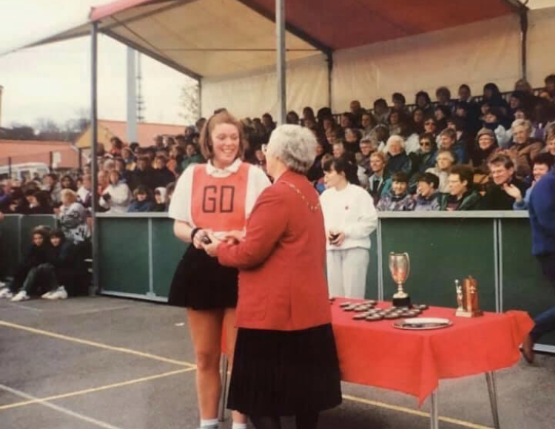
Past Captains
Under 21’s
Seniors
1993-1994 – Pip Mcleod (nee Burns)
Late 70’s/Early 80’s – Joan Dunn
1994 – 2001 – Pip McLeod (nee Burns)

